Slide 1
Unit -3

Slide 2
Objective
IP new generation.
Auto configuration and Renumbering.
Packet Format
Transition

Slide 3
IP v6 - Version Number
IP v 1-3 defined and replaced
IP v4 - current version
IP v5 - stream protocol
  Connection oriented internet layer protocol(VOIP)
IP v6 - replacement for IP v4
  Not compatible with IP v4
  During the initial development it was called Ipng.
Expanded address space
  128 bit
  6*10²³ addresses per square meter on earth!

Slide 4
Main changes in IPv6
Larger address space..
Better header format.
New options.
Allowance for extension.
Support for resource allocation.
Support for more security.

Slide 5
22.1 IPv6 ADDRESSING
IPv6 address is 128 bits.
Representation:
  Binary (128 bits) 1111111011110110 … 1111111100000000
  Colon Hexadecimal FEF6:BA98:7654:3210:ADEF:BBFF:2922:FF00
Abbreviation : (zero compression )
  Even in hexadecimal format, is very long.
  The leading zeros of a section can be omitted.
  0074 can be written as 74
  000F as F, and 0000 as 0

Slide 6
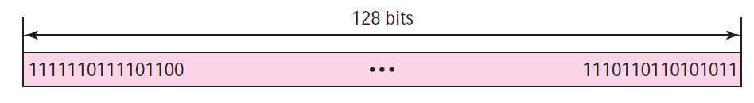

IPv6 address
Colon Hexadecimal Notation

Slide 7
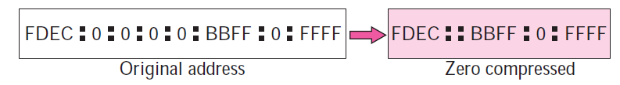
Zero compression: In colon hex notation if there are consecutive sections consisting of zeros only. We can remove all the zeros and replace them with a double semicolon.
Mixed Notation
  Mixed representation of an IPv6 address: colon hex and dotted decimal notation. Ex: ::130.24.24.18
  Transition period.
  IPv6 address are 0s.

Slide 8
CIDR Notation
  IPv6 uses hierarchical addressing.
  IPv6 allows slash or CIDR notation.
  FDEC::BBFF:0:FFFF/60

Slide 9
Question
Show the unabbreviated colon hex notation for the following IPv6 addresses:
  a. An address with 64 0s followed by 64 1s.
  b. An address with 128 0s.
  c. An address with 128 1s.
  d. An address with 128 alternative 1s and 0s.
Solution
  a. 0000:0000:0000:0000:FFFF:FFFF:FFFF:FFFF
  b. 0000:0000:0000:0000:0000:0000:0000:0000
  c. FFFF:FFFF:FFFF:FFFF:FFFF:FFFF:FFFF:FFFF
  d. AAAA:AAAA:AAAA:AAAA:AAAA:AAAA:AAAA:AAAA

Slide 10
The following shows the zero contraction version of addresses in Example 26.1 (part c and d cannot be abbreviated)(Hint Zero Compression ).
Solution:
  a. ::FFFF:FFFF:FFFF:FFFF
  b. ::
  c. FFFF:FFFF:FFFF:FFFF:FFFF:FFFF:FFFF:FFFF
  d. AAAA:AAAA:AAAA:AAAA:AAAA:AAAA:AAAA:AAAA

Slide 11
Show abbreviations for the following addresses:
  a. 0000:0000:FFFF:0000:0000:0000:0000:0000
  b. 1234:2346:0000:0000:0000:0000:0000:1111
  c. 0000:0001:0000:0000:0000:0000:1200:1000
  d. 0000:0000:0000:0000:0000:FFFF:24.123.12.6
Solution
  a. 0:0:FFFF::
  b. 1234:2346::1111
  c. 0:1::1200:1000
  d. ::FFFF:24.123.12.6

Slide 12
Decompress the following addresses and show the complete unabbreviated IPv6 address:
  a. 1111::2222
  b. ::
  c. 0:1::
  d. AAAA:A:AA::1234
Solution
  a. 1111:0000:0000:0000:0000:0000:0000:2222
  b. 0000:0000:0000:0000:0000:0000:0000:0000
  c. 0000:0001:0000:0000:0000:0000:0000:0000
  d. AAAA:000A:00AA:0000:0000:0000:0000:1234

Slide 13
22.1.2 Address Space
IPv6 contains 2¹²⁸ addresses.
Each person can have 2⁸⁸ addresses to use.
Three Address Types
  Unicast Address
  Anycast Address
  Multicast Address

Slide 14
Types of Address
Unicast Address: Single interface and Unicast address.
Anycast Address :
  Group of computers that all share a single address.
  Delivered to only one member of the group.
  Example: Request to Server.
  IPv6 does not designate a block.
Multicast Address :
  Defines a group of computers.
  Each member of the group receives a copy
  IPv6 has designated a block for multicasting.

Slide 15
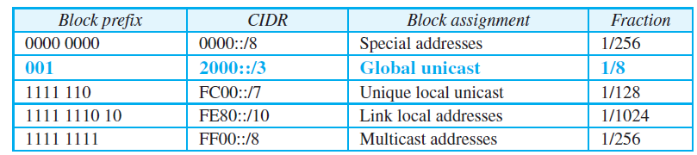
22.1.3 Address Space Allocation
The address space of IPv6 is divided into several blocks.

Slide 16

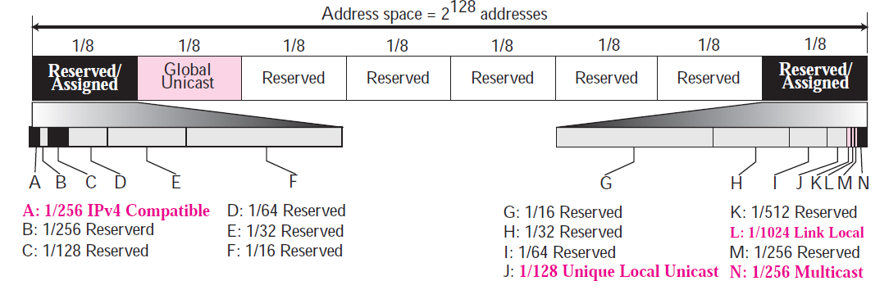
Address space allocation

Slide 17
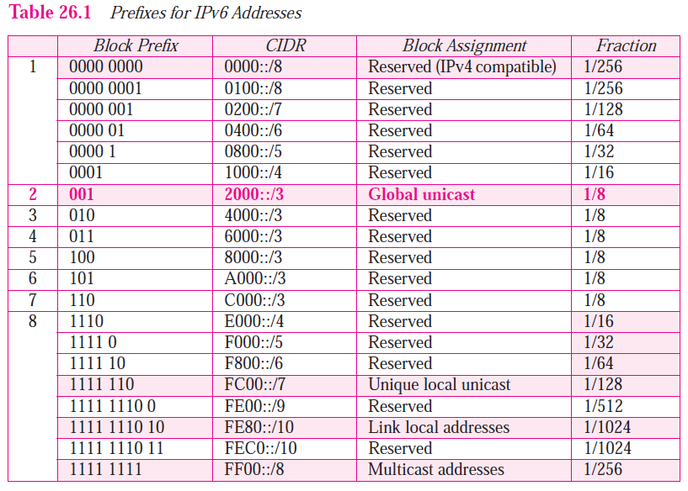

Slide 18
Global Unicast Addresses
It used for Unicast (one-to-one) communication between two hosts called global Unicast address block.
CIDR for the block is 2000::/3.
Block Prefix is 001.
Size of the block is 2^{125.}
Address Block divided three parts:
  global routing prefix (n bits).
  subnet identifier (m bits) and
  interface identifier (q bits)

Slide 19
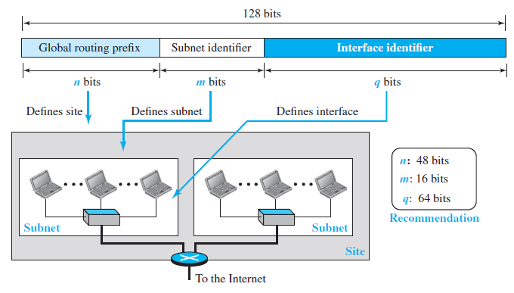
Global Unicast address

Slide 20
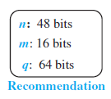
The first three bits in this part are fixed (001)
Defined for up to 2⁴⁵ sites (a private organization or an ISP).
An organization can have up to 2¹⁶ = 65,536 subnets.
The last q bits (64 bits based on recommendation) define the interface identifier.
Eliminating the mapping process.

Slide 21
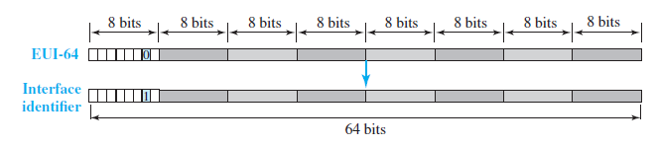
Mapping EUI-64 (extended unique identifier)
To be changed from 0 to 1 (local to global) to define an interface address.
https://www.youtube.com/watch?v=Q437tNX-WFU

Slide 22
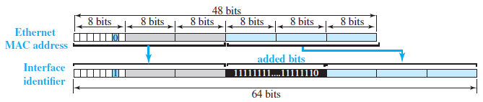
Mapping Ethernet MAC Address
Mapping a 48-bit Ethernet address into a 64-bit interface identifier.
Insert an additional 16 bits, defined as 15 ones followed by one zero, or FFFE_{16.}
https://www.youtube.com/watch?v=Q437tNX-WFU

Slide 23
Example
LINK LOCAL IPv6 Address: FE80: : 20C:CFFF:FEA2:35AD
MAC Address or Physical address : 000C.CFA2.35AD
Now how to get IPv6 interface address using MAC.
https://www.youtube.com/watch?v=acXQVhsYkoU

Slide 24
Example 22.2
Using the format we defined for Ethernet addresses, find the interface identifier if the physical address in the EUI is
(F5-A9-23-EF-07-14-7A-D2)₁₆.
Solution:
We only need to change the seventh bit of the first octet from 0 to 1 and change the format to colon hex notation. The result is
  F7A9:23EF:0714:7AD2.

Slide 25
Example 22.3
Using the format we defined for Ethernet addresses, find the interface identifier if the Ethernet physical address is
(F5-A9-23-14-7A-D2)₁₆.
Solution:
We only need to change the seventh bit of the first octet from 0 to 1, insert two octets FFFE₁₆ and change the format to colon hex notation. The result is
F7A9:23FF:FE14:7AD2 in colon hex.

Slide 26
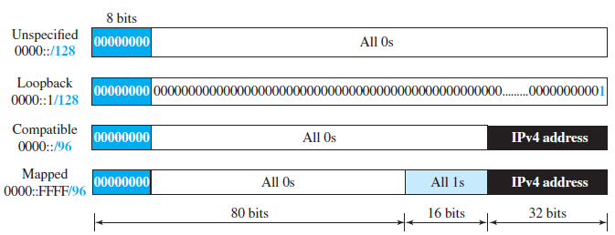
Special Addresses
Addresses that use the prefix (0000::/8) are reserved.

Slide 27
Special Addresses
Unspecified address: Used during bootstrap.
Loopback address: Only one address.
Used During Transition from IPv4 to IPv6
  Compatible address and Mapped address
Compatible address: It is used when a computer using IPv6 wants to send a message to another computer using IPv6.
Ex: The IPv4 address 2.13.17.14 (in dotted decimal format) becomes 0::2.13.17.14 (in mixed format). The IPv4 address is pretended with 96 zeros to create a 128-bit IPv6 address
https://tools.ietf.org/html/rfc5156

Slide 28
Mapped address : It is used when a computer already migrated to version 6 wants to send an address to a computer still using version 4.
Packet travels mostly through IPv6 networks but is finally delivered to a host that uses IPv4.
Ex: The IPv4 address 2.13.17.14 (in dotted decimal format) becomes 0::FFFF:2.13.17.14 (in hexadecimal colon format). The IPv4 address is pre pended with 16 ones and 80 zeros to create a 128-bit IPv6 address

Slide 29
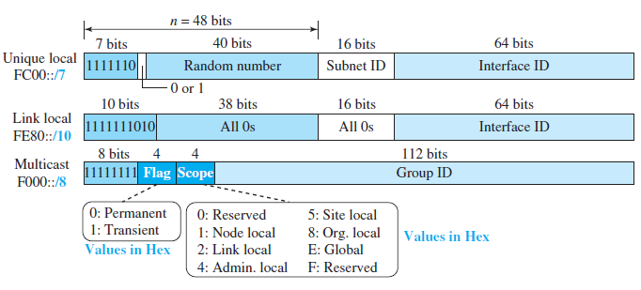
Other Assigned Blocks
IPv6 uses two large blocks for private addressing.
  Unique local Unicast Block
  Link local Block

Slide 30
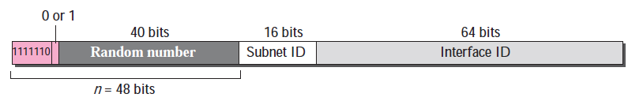
Unique Local Unicast Block
Privately created and SITE.
Not expected to be routed.
Define how the address is selected (locally or by an authority) – 0 or 1.
Site using a randomly generated number.
Probability of duplication of the address.

Slide 31
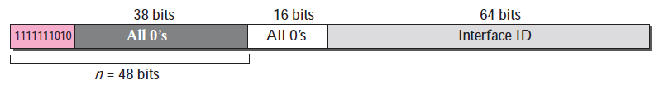
Link Local Block
Designed for private addresses and for private network.
Block identifier 1111111010.
The next 54 bits are set to zero..

Slide 32
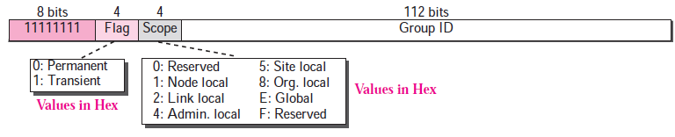
Multicast Block
In IPv6 a large block of addresses are assigned for multicasting.
Addresses use the prefix 11111111.
Flag- permanent or transient.
  Ex: Systems engaged in a teleconference
Scope of the group address

Slide 33
22.1.4 Auto configuration
IPv6 addressing is the auto configuration of hosts.
IP v4 , Dynamic Host Configuration Protocol.
In IPv6, DHCP protocol can still be used to allocate an IPv6 address to a host.
Also a host can also configure itself.
When a host in IPv6 joins a network. it can configure itself using the following process:

Slide 34
A host in IPv6 joins a network
The host first creates a link local address for itself.
The host then tests to see if this link local address is unique and not used by other hosts. Interface identifier is supposed to be unique. The host sends a neighbor solicitation message. If any one using, process fail.
If the uniqueness of the link local address is passed, the host stores this address as its link-local address (for private communication), but it still needs a global Unicast address. The host then sends a router solicitation message to a local router.

Slide 35
Example 22.5
Assume a host with Ethernet address (F5-A9-23-11-9B-E2)₁₆ has joined the network. What would be its global Unicast address if the global unicast prefix of the organization is 3A21:1216:2165 and the subnet identifier is A245:1232?

Slide 36
Solution
The host first creates its interface identifier as F7A9:23FF:FE11:9BE2 using the Ethernet address read from its card. The host then creates its link local address as:
FE80::F7A9:23FF:FE11:9BE2
The host sends a router solicitation message and receives the router advertisement message that announces the combination of global unicast prefix and the subnet identifier as 3A21:1216:2165:A245:1232. The host then appends its interface identifier to this prefix to find and store its global unicast address as:
3A21:1216:2165:A245:1232:F7A9:23FF:FE11:9BE2

Slide 37
Renumbering
To migrate to a new address
  Change of provider
  Change in network architecture
Methods :
  router adds a new prefix in RA, and informs that the old prefix is no longer valid.
  DHCP lease runs out, assign a new address to node.
  DHCPng can ask nodes to release their addresses.
Requires DNS update. DHCPng can update DNS for clients.

Slide 38
22.2 THE IPv6 PROTOCOL
IPv6 decided to implement remedies.
Shows other changes implemented in the protocol.
  Better header format.
  New options.
  Allowance for extension.
  Support for resource allocation.
  Support for more security.

Slide 39
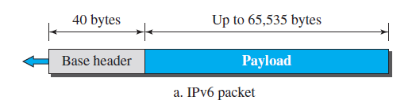
22.2.1 Packet Format
Each packet is composed of a base header followed by the payload.
Base header occupies 40 bytes.
Payload can be up to 65,535 bytes of information.

Slide 40
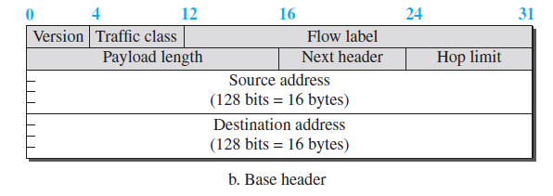
Figure 22.6 IPv6 datagram

Slide 41
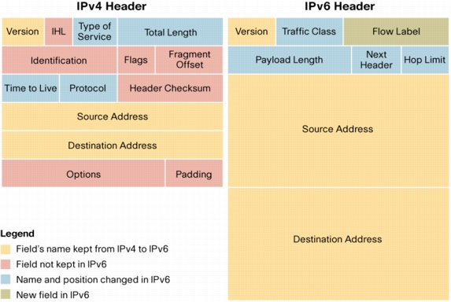
IPv6 v/s IPv4 Header

Slide 42
IPv6 Header Fields
Version: 4-bit version field and value is always 6.
Traffic class: 8-bit traffic class field.
  Used distinguish different payloads with different delivery requirements. It replaces the type-of-service field in IPv4.
Flow label: 20-bit field that is designed to provide special handling for a particular flow of data.
Payload length (16- bit field) : Length of the packet following the IPv6 header, in octets.
Next header (8-bit field): The type of header immediately following the IPv6 header.

Slide 43
IPv6 Header Fields
Hop limit (8-bit field) :Decremented by 1 by each node that forwards the packet.
Source Address (128-bit field) : An address of the initial sender of the packet.
Destination Address (128-bit field): An address of the intended recipient of the packet.

Slide 44
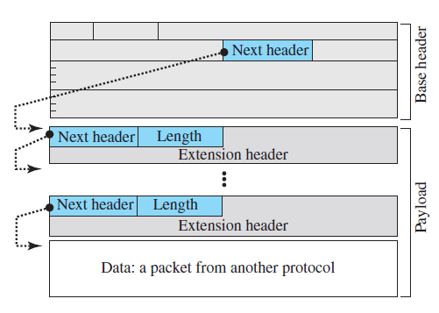
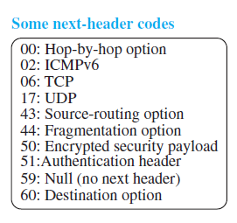
Payload: In IPv6 is different format and meaning

Slide 45
Concept of Flow and Priority in IPv6
Flow label directly added, use IPv6 as a connection-oriented protocol.
In Simplest form, a flow label , processing packet. (Flow label Table)
To a router, Flow is sequence of packets.
  Same Characteristics.
  Provided information about hop by hop and other protocol. ( Flow label Table)
Sophisticated, support transmission of real-time audio and video. Also for reservation of resource.

Slide 46
Fragmentation and Reassembly
IPv6 datagrams can be fragmented only by the source .
Fragmentation of a packet in a router needs a lot of processing.
All fields related to the fragmentation need to be recalculated.
Drop it if the size is larger than allowed by the MTU of the network ahead.
Router then sends a packet-too-big ICMPv6 error message

Slide 47
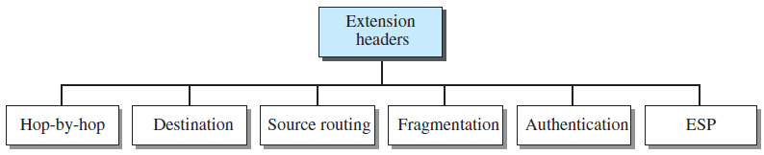
22.2.2 Extension Header
Six types of extension headers have been defined.

Slide 48
Hop-by-Hop Option
hop-by-hop option is used by the source.
Routers must be informed about certain management, debugging, or control functions
Only three hop-by- hop options have been defined.
  Pad1: 1 byte long and is designed for alignment purposes.
  PadN: PadN is similar in concept to Pad1.
  Jumbo payload: if for any reason a longer payload is required.

Slide 49
Destination Option : It is used when the source needs to pass information to the destination only.
Source Routing : The concepts of the strict source route and the loose source route options of IPv4

Slide 50
Fragmentation
Fragmentation in IPv6 is the same as that in IPv4.
In IPv6, only the original source can fragment.
A source must use a Path MTU Discovery technique to find the smallest MTU.

Slide 51
Authentication : Dual purpose
  Validates and integrity of data.
Encrypted Security Payload (ESP) : Provides confidentiality
  Guards against eavesdropping

Slide 52
Comparison of Options between IPv4 and IPv6
The no-operation and end-of-option options in IPv4 are replaced by Pad1 and PadN options in IPv6.
The record route option is not implemented in IPv6 because it was not used.
The timestamp option is not implemented because it was not used.
The source route option is called the source route extension header in IPv6.
The fragmentation fields in the base header section of IPv4 have moved to the fragmentation extension header in IPv6.
The authentication extension header is new in IPv6.
The encrypted security payload extension header is new in IPv6.

Slide 53
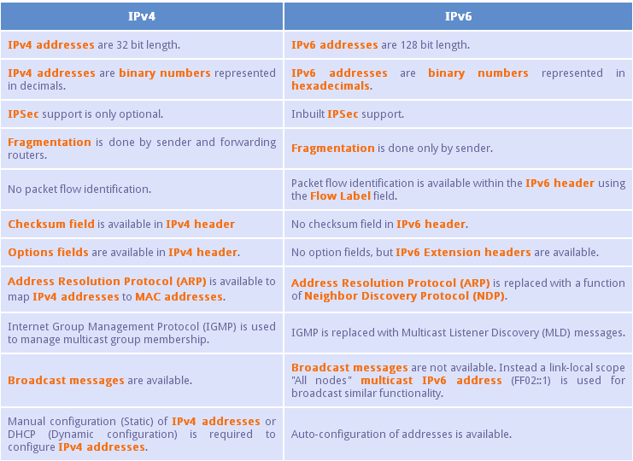
Comparison of Options between IPv4 and IPv6

Slide 54
22.4 TRANSITION FROM IPv4 TO IPv6
Not practical possible.
Strategies
Use of IP Addresses

Slide 55
22.4.1 Strategies
Three strategies :
  Dual stack
  Tunneling
  Header translation

Slide 56
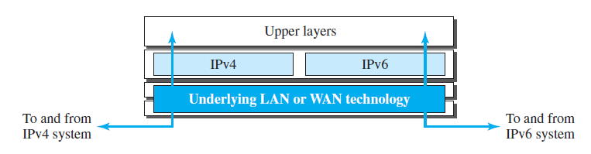
Dual Stack
Dual stack of protocols.
A station must run IPv4 and IPv6 simultaneously until all the Internet uses IPv6.
When sending a packet to a destination, the source host queries the DNS.

Slide 57
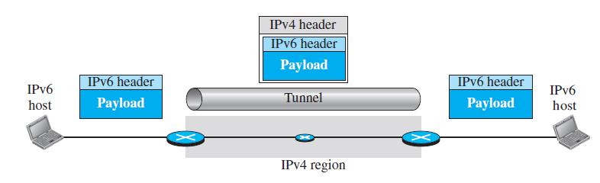
Tunneling
Two computers using IPv6 want to communicate.
Packet must pass through a region that uses IPv4.
IPv6 packet is encapsulated.
IPv4 packet is carrying an IPv6 packet as Data Protocol value is set to 41.

Slide 58
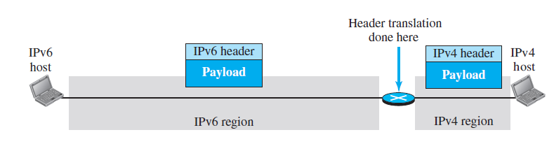
Header Translation
Header translation is necessary when the majority of the Internet.
Sender wants to use IPv6, but IPv4 don’t understand it.
The header format must be totally changed through header translation.

Slide 59
22.4.2 Use of IP Addresses
A host may need to use two addresses, IPv4 and IPv6.
IPv4 addresses should disappear.
IPv4 directory will disappear

Slide 60
Problem
Show the original (unabbreviated) form of the following addresses:
  a. 0::2
  b. 0:23::0
  c. 0:A::3
  d. 123::12:23

Slide 61
Using the CIDR notation, show the IPv6 address compatible to the IPv4 address 129.6.12.34.
Solution : The address is ::129.6.12.34/128
Using the CIDR notation, show the IPv6 loopback address.
Solution :The address is ::01/128.

